Slide 1
2D Multiplayer Game Idea
Pitch Presentation
Ajil Pappachan
L4 GDV

Slide 2
Objective: To Pitch Ideas for a 2D Multiplayer Game to be Developed in Unity

Slide 3
IDEA 1 -
SPIDER

Slide 4
Game Overview
2D Board Game
2-6 Player Game​
Start from the Centre of the Board​
Turn based gameplay​
Movement of Characters decided by a spinning wheel​
Objective is to reach either end of the board​

Slide 5
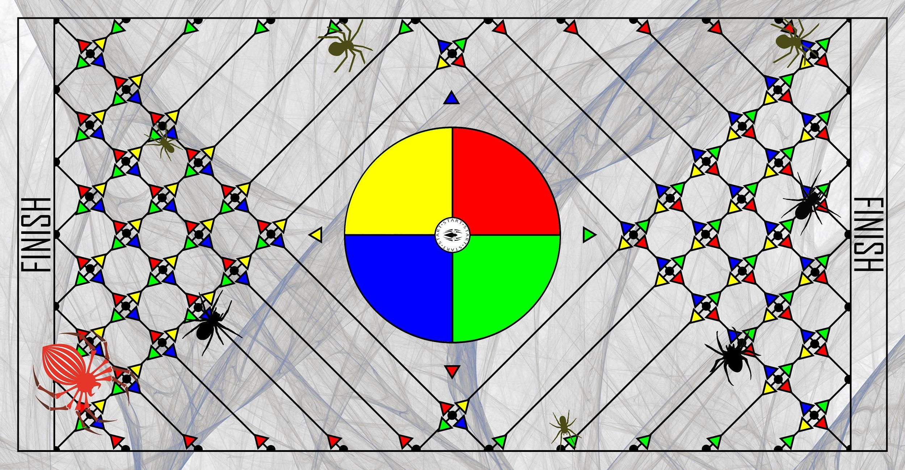
Board Design

Slide 6
Game Elements : Action
The players spin a wheel to generate a random color which determines the next movement of their avatar.

Slide 7
Game Elements : Rules
1-6 Player Game​
Turn based gameplay. Players can take turns in any order​
All Players Start from the Centre (On top of the Spinning wheel)​
Each Player Spins the Wheel and moves their Character in one of the 4 Possible directions as instructed by the Wheel​
Game doesn't end till every Player reaches either end of the board​
First Player to reach the end of the board wins the game​

Slide 8
Game Elements : Rewards
The Game doesn’t end until all players reach the finish. The players are ranked based on the order in which they reached the finish.

Slide 9
Game Elements : Objectives
The objective of the players is to reach the finish line before their opponents, while also avoiding enemy spiders in the way.

Slide 10
Game Elements : Assets
Sprites for Player Characters
Sprites for Enemy Spiders
Rotating Wheel
Background Image

Slide 11
Game Elements : Competition
Players compete with other players to reach the finish line before them.

Slide 12
Game Elements : Challenges
The Players face the challenge of reaching the finish line before their opponents, while also trying to avoid enemy spiders.

Slide 13
Game Elements : Target Audience
The Game is targeted at younger audience with spare time and are not affected by staring at bright colors for extended periods of time.

Slide 14
IDEA 2 -
Dirty Soul

Slide 15
Game Overview
1-2 Player Game
Game takes place inside human body.
Player controls an Antibody which fights against attacking germs, bacteria and viruses.
Player has to be careful not to attack internal organs.
Game ends when the human body takes too much damage.
Score is calculated by survive time.

Slide 16
Game Elements : Action
The players navigate through a cross sectional view of the human body, trying to fend off invading germs, bacteria, viruses, etc.

Slide 17
Game Elements : Rules
1-2 Player Game​
Players can move around anywhere in the screen, but cannot pass through internal organs
Camera is locked on the players, and can move vertically to reveal more of the game map (Human Body), if/when both the players move in that direction
Players can shoot “Antigens” (at a limited rate of fire).
The enemies will try to attack the internal organs, and if the player hits said organs by accident, damage will be dealt to it.
If Player collides with any enemy or obstacle, a life is lost.
Power ups are generated at random times by different organs.
Points are added automatically with passage of time. Extra points are received for killing enemies.
The game ends when the human takes too much damage.

Slide 18
Game Elements : Rewards
Power Ups are awarded by different internal organs
Score is awarded based on the survive time of the players, as well as lives left and damage dealt to enemies

Slide 19
Game Elements : Objectives
The objective of the players is to defend the human body by defeating invading enemies

Slide 20
Game Elements : Assets
Sprites for Player Characters
Sprites for Enemies
Sprites for Internal Organs
Sprites for Power Ups
Sprites for Projectile “Antigen”
Background Image

Slide 21
Game Elements : Competition
Players compete with other players to attain high scores, and also try to beat their own high score.

Slide 22
Game Elements : Challenges
The Players face the challenge of trying to survive for as much time as possible, while also attacking invading enemies.

Slide 23
Game Elements : Target Audience
The Game is targeted at younger adults.

Slide 24
IDEA 3 -
Evolution 2D

Slide 25
Game Overview
2 Player Game
Homage to different 2D games of the past
Game takes place in a helical 2D world
First player to reach the top of the world wins

Slide 26
Game Elements : Action
Players start at the bottom of a helical world at either sides and they climb upwards, playing different Mini games at each step of the way, based on a historical 2D game.

Slide 27
Game Elements : Rules
2 Player Game
Players start from the bottom of a helical world, at either end
Players climb up the world through platforms
Rules of the game vary at different parts of the world

Slide 28
Game Elements : Rewards
Victory is awarded to the first player to reach the top
But, the biggest reward is Nostalgia

Slide 29
Game Elements : Objectives
The objective of the players is to be the first to reach the top of the game world, by competing with each other in mini games based on historical 2D games

Slide 30
Game Elements : Assets
Sprites for the Players
Sprites for the Platforms
Different Mini-Games
2D Helical World

Slide 31
Game Elements : Competition
Players compete with each other to complete mini games and be the first to reach the top of the game world.

Slide 32
Game Elements : Challenges
The Players face the challenge of trying to beat each other in mini games and reach the top of the game world.

Slide 33
Game Elements : Target Audience
The Game is targeted at older audiences, who grew up playing retro 2D games.

Slide 34
THE END
Thank You

